Slide 1
SEMINARIO DE TECNOLOGIA
Servidores SPARC
HP ProLiant server
Cluster en SPARC
Integrantes
Alejandro Abraham
Esteban Ventura
Juan Pablo Carro

Slide 2
Servidores SPARC

Slide 3
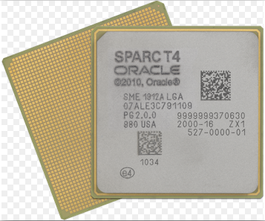
Arquitectura SPARC
Scalable Processor Architecture
Son procesadores RISC
Últimas Generaciones a la fecha
T4 de Oracle
SPARC 64 VII/VII+ de Fujitsu
Notes:
Scalable Processor Architecture
Son procesadores RISC (es decir utilizan un conjunto de instrucciones reducidas)
Diseñado por Sun Microsystems
Es la primera arquitectura RISC abierta
Nos centraremos en la última generación, T4 de Oracle y SPARC 64 VII/VII+ de Fujitsu
T4 fue introducido en 2011
Están diseñados para ofrecer una alta performance en procesamiento multi-hilo
8 Hilos por núcleo, 8 núcleos por Procesador
Frecuencias entre 2.85 y 3.0 GHz
Tamaño del procesador 40 nm
SPARC 64 VII/VII+ introducidos en 2008/2010 respectivamente
2 hilos por núcleo, 4 núcleos por Procesador
Frecuencias entre 2.52 GHz y 3.0 GHz
Tamaño del procesador 65 nm

Slide 4
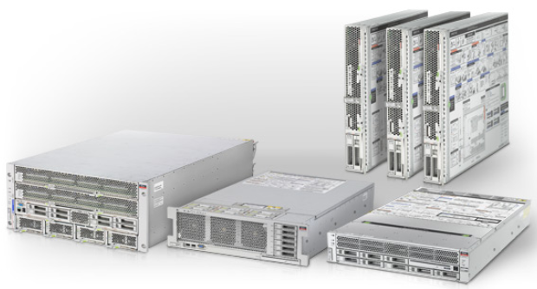
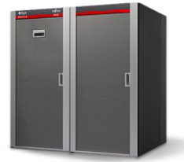
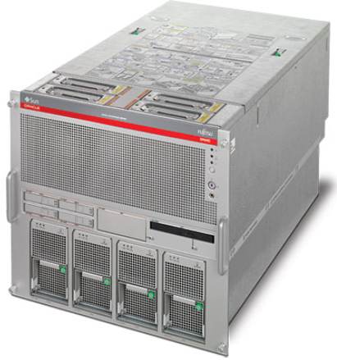
Oracle SPARC
SPARC T-Series Servers
SPARC Enterprise M-Series Servers

Slide 5
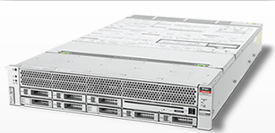
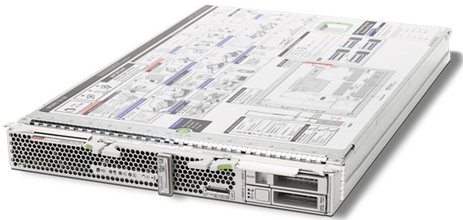
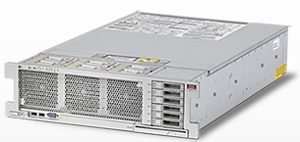
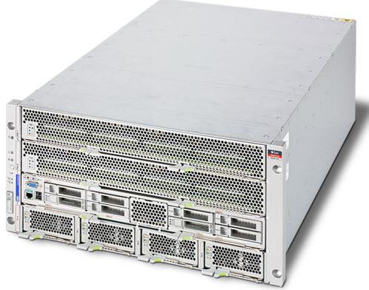
SPARC T-Series Servers
SPARC T4-1 Server
SPARC T4-1B Server Module
SPARC T4-2 Server
SPARC T4-4 Server

Slide 6
SPARC T-Series Servers
Categoría | Modelo | Procesadores (Capacidad Max.) | Cores (Max) | Threads (Max) | Internal HDD (Max) | Memoria Principal (Max) | Bahías/Slots
Entry Level | SPARC T4-1 2U | 1 SPARC T4 2.85GHz | 8 | 64 | 4.8 TB SAS 2.4 TB SDD (8 discos) | 256 GB (16 DIMM x board x 16 GB DDR3) | Red 4x 1Gb Ethernet 4x USB 2.0 1x VGA
 | SPARC T4-1B 1 blade | 1 SPARC T4 2.85GHz | 8 | 64 | 1.2 TB SAS 200 GB SDD (2 discos) | 256 GB (16 DIMM x board x 16 GB DDR3) | Red 2x 10/100/1000 Ethernet 1x 10/100 Ethernet dedicado 4 x8 PCIe 2 x USB 2.0 1x HD-15 Video out
Mid Size | SPARC T4-2 3U | 2 SPARC T4 2.85GHz | 16 | 128 | 3.6 TB SAS 1.8 TB SDD (6 discos) | 512 GB (32 DIMM x board x 16 GB DDR3) | Red 4x 1GB Ethernet 8 PCIe x8 2 PCIe x4 4 x USB 2.0 1 x VGA
High End | SPARC T4-4 5U | 4 SPARC T4 3.0GHz | 32 | 256 | 4.8 TB SAS 2.4 TB SDD (8 discos) | 1 TB (64 DIMM x board x 16 GB DDR3) | Red 2x QSFP ports (10 GB) 4x 1Gb Ethernet ports 16x PCIe x8 slots 4 x USB 2.0 2x RJ45 port 1 x VGA

Slide 7
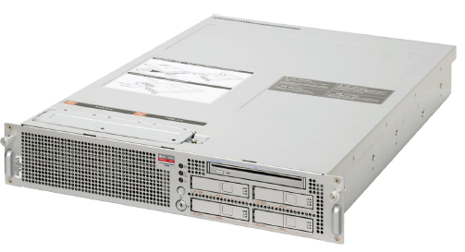
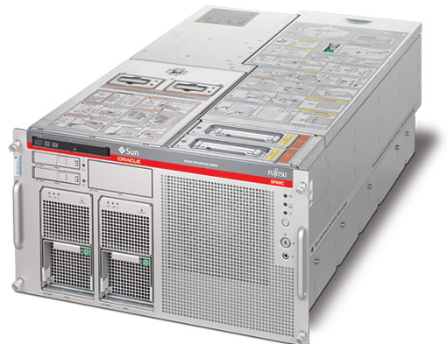
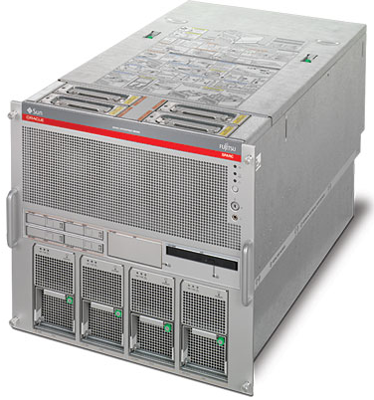
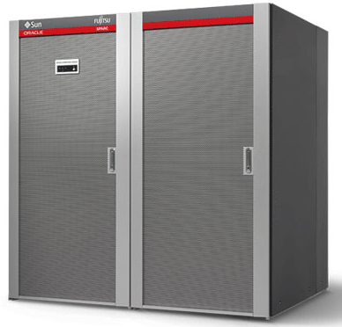
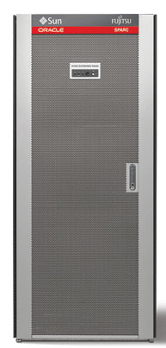
SPARC Enterprise M-Series Servers

Slide 8
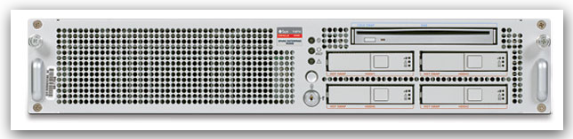
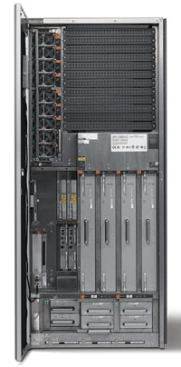
SPARC Enterprise M-Series Servers
Cat | Modelo | Foto | Procesadores (Capacidad Max.) | Core Max | Thread (Max) | Internal HDD | Memoria Principal (Max) | Bahías/Slots
Entry Level | M3000 2U |  | 1 SPARC64 VII+: 2.86 GHz | 4 | 8 | 2.4 TB (4 discos) SAS 600 GB | 64 GB (8 GB DIMM) | 4X Gb Ethernet ports 4 x PCIe (x8)
Mid Size | M4000 6U |  | 4 SPARC64 VI 2.15 GHz SPARC64 VII+ 2.66 GHz | 16 | 32 | 1.2 TB (2 discos) SAS 600 GB | 256 GB (64 GB x board x 4) 8 GB DIMM | 2 × Gb Ethernet ports 2 × 10/100 ethernet 1 × PCI-X Slot 4 × PCIe Slots 1 x RJ45
 | M5000 10U |  | 8 SPARC64 VI 2.15 GHz SPARC64 VII+ 2.66 GHz | 32 | 64 | 2.4 TB (4 discos) SAS 600 GB | 512 GB (64 GB x board x 8) 8 GB DIMM | 2 x Gb Ethernet 1 x PCI-X 4 x PCIe (hasta 4 boards)
High End | M8000 |  | 16 SPARC64 VI 2.28/2.4 GHz SPARC64 VII 2.88 GHz SPARC64 VII+ 3.0 GHz | 64 | 128 | 9.6 TB (16 discos) SAS 600 GB | 1 TB (64 GB x board x 16) 8 GB DIMM | 2 × 10/100 Ethernet 32 x PCIe
 | M9000 |  | 64 SPARC64 VII+: 3.0GHz SPARC64 VII: 2.88 GHz | 256 | 512 | 38.4 TB (64 discos) SAS 600 GB | 4 TB (64 GB x board x 64) 8 GB DIMM | 2 x 10/100 Ethernet 128 x PCIe

Slide 9
HP ProLiant server

Slide 10
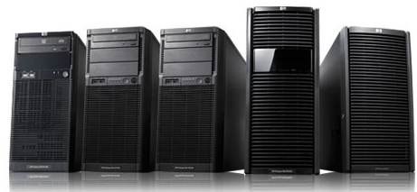
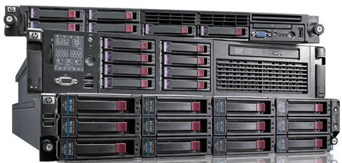
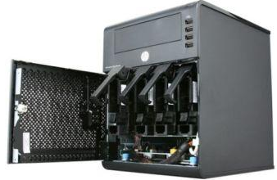
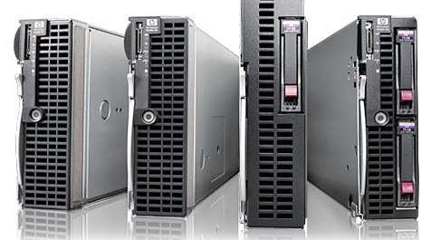
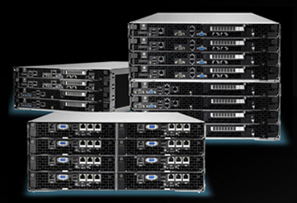
Servidores HP ProLiant
Formatos físicos de la familia
Modular Line (ML)
Density Line (DL)
Micro Server
Blade Servers (BL)
Scalable System SL
Notes:
Intro:
HP ProLiant systems are top-selling servers, and every third server sold worldwide is an HP server.
Tipos de servidores
Modular Line (ML): expandable tower servers for small to medium-sized businesses.
Density Line (DL): Powerful servers in 1, 2, 4, 7, or 8U configurations as well as multinode server designs, all enhanced for a rack-mounted server environment. Optimizados para bastion?
Blade Servers (BL): Compact y ultradensos, ideales para espacio limitado
Scalable System (SL): A new server family that enables a shared server infrastructure enhanced
for extreme scale-out deployments.
Microserver: Server de proposito general compacto para empresas con menos de 10 clientes conectados.

Slide 11


Servidores HP ProLiant
Nomenclatura de series
Nivel de procesamiento
Último dígito
100
Entry level
XX5
300
500
XX0
High end
Notes:
Series
Los modelos partes de la serie 100, que es el entry level usualmente de single / dual socket
Pasando por la serie 300 que es de rango medio y la 500 de alta performance.
Hay series adicionales, las cuales no son parte de esta presentacion como la 900, la 2000 que es multinodo, etc
100: Simple, powerful and affordable 2-processor rack mount servers
300: Versatile, general-purpose 1- 2 processor rack mount servers
500: Scalable, workhorse 4-processor rack mount servers

Slide 12

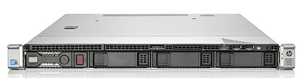
Servidores HP ProLiant – Serie 100
Línea | DL120 (G7) | DL160 (G8)
Procesador | Intel® Xeon® E3, Core™ i3, Pentium Celeron®. Hasta 1 procesador | Intel® Xeon® E5-2600, hasta 2 procesadores
Cores | 2 o 4 | De 2 a 8 por procesador Total: hasta 16 nucleos si hay 2 procesadores.
Cache | Hasta 8 mb | Desde 5mb (dual core) hasta 20 (8 cores)
Memoria | Hasta 16 gb DDR3 1333. 4 slots DIMM. | Max 384GB en 24 dimms Soporta DDR3 1333 mhz
Storage | Hot plug 3.5-inch SATA/SAS Hot plug 2.5-inch SATA/SAS Bahias: Hot-Plug 4 LFF SAS/SATA (4 x 2TB) Hot-Plug 8 SFF SAS/SATA (8 X 1 TB) Maximo 8TB | Hot plug 2.5-inch SAS/SATA Hot plug 3.5-inch SAS/SATA, Hot plug SFF SSD Bahias: 4 LFF : SATA y SAS: Max 12 TB (4 x 3TB) SATA SSD Max 1.6TB (4 x 400gb) 8 SFF : SATA y SAS: 8 TB = 8 X 1 TB SATA SSD: 3.2TB = 8 X 400 GB SAS SSD: 6.4TB = 8 X 800GB
Slots exp. | 2 PCIe 2.0 (x16 y X8) | (2) PCIe 3.0 (x16 y x8)
Otros | Standard power suply Form factor: 1 U | Standard power suply Form factor: 1U
Notes:
DL 120
Internal Storage Devices
Drives :Optical Drive Optional 9.5mm DVD-ROM, or DVD-RW Drive
Hard Drives:
One of the following depending on Model
Entry Model:
(Cold Plug) Up to 4 pluggable SATA/SAS 3.5" drives supported.
1x250GB pluggable SATA 3.5" drive ships standard
NOTE: SAS requires optional HBA or SA card
NOTE: SATA Hot Plug functionality available via Hot Plug Advance Pack for B110i
Base Model (Cold Plug)
Up to 4 pluggable SATA/SAS 3.5" drives supported.
1x250GB pluggable SATA 3.5" drive ships standard
NOTE: SAS requires optional HBA or SA card.
NOTE: SATA Hot Plug functionality available via Hot Plug Advance Pack for B110i
Performance Model (Hot Plug)
Up to 4 hot plug SATA/SAS 3.5" drives supported. None ships standard
Maximum Internal Storage
One of the following depending on Model
Hot Plug SAS 8.0TB (4 x 2TB) 3.5" SAS
Hot Plug SATA 8.0TB (4 x 2TB) 3.5" SATA
HP ProLiant DL120 G7 Hot Plug 8 SFF Configure-to-order Server 647340-B21
NOTE: This configuration requires the HP Smart Array P410 Controller be purchased
separately to support 8SFF HDDs.
DL 160
Maximum Internal Storage
One of the following depending on Model
Hot Plug LFF SATA y SAS: 12.0TB 4 x 3TB
Hot Plug LFF SATA SSD 1.6TB 4 x 400GB
Hot Plug SFF SATA y SAS: 8.0TB = 8 x 1TB
Hot Plug SFF SATA SSD 3.2TB 8 x 400GB
Hot Plug SAS SSD 6.4TB 8 x 800GB

Slide 13


Servidores HP ProLiant – Serie 300
Línea | DL360p (G8) | DL380 (G8)
Procesa-dor | Familia Intel Xeon E5-2600 1 o 2 procesadores | Intel® Xeon® E5-2600 2 procesadores
Cores | De 2 a 8 por procesador
Cache | Desde 5 mb (dual core) hasta 20 (p/ 8 cores) | Desde 5mb (dual) hasta 20mb (para 8 cores)
Memoria | Hasta 768 gb: 24 slots de memoria dimm (12 por procesador). C/ slot soporta hsta 32 gb y hasta 1600mhz Tecnologias soportadas: Ddr3
Storage | Bahías: 8 SFF SAS, SATA: up to 8.0TB= 8 X 1 TB SAS SSD: up to 6.4 TB = 8 x 800 GB SATA SSD: up to 3.2 TB = 8 x 400 GB ó 4 LFF SAS & SATA: Up to 12TB: 4 x 3TB ** 4 LFF SATA SSD: up to 1.6TB = 4 x 400 ** Máximo: 12 TB | 16 SFF SAS/SATA with optional second drive cage Bahías: Non-hot plug 3.5-inch SATA Hot Plug SFF SAS & SATA: Up to 16.0TB 16 x 1TB * Hot Plug SFF SAS SSD 12.8TB 16 x 800GB * Hot Plug LFF SAS & SATA: Up to 24.0TB = 8 x 3TB ** Hot Plug LFF SATA SSD: Up to 3.2TB = 8 x 400GB **
Slots de expansión | 2x PCIe 3.0 Slots for x16 Full-height, Half-length and x8 low profile option cards Maximum | Primary:2 PCIe 3.0 (16X/8X/) 1 PCIe 2.0 (X4) Optional 3 slot riser (x16, x8, x8), or 2 slot (x16, x16)
Otros | Form factor: 1 U Hot plug redundante power supply | Form factor: 2U Hot plug redundante para modelos gama alta, opcional para entry y modelos base
** con jaula (drive cage) LFF opcional
* con jaula (drive cage) SFF opcional
Notes:
Fuente http://h10010.www1.hp.com/wwpc/us/en/sm/WF05a/15351-15351-3328412-241644-241475-5177957.html?dnr=1
DL360
Internal Storage Devices Diskette Drive None
Optical Drive Optional DVD-ROM, DVD-RW
NOTE: This option available with all 8SFF or 4LFF drive bay models.
Hard Drives None ship standard
Hard Drive Bays 8 SFF drive bays total with Optical drive bay
Optional: 4 LFF bays with Optical drive bay.
NOTE: HP ProLiant DL360p Series servers offer both SFF, and LFF versions in CTO. The Optical Drive bay is available with both models.
NOTE: LFF versions is not an upgradeable option from SFF models, or viceversa.
Maximum Internal Storage
Hot Plug SFF SAS 8.0TB 8 x 1TB
Hot Plug SFF SATA 8.0TB 8 x 1TB
Hot Plug SFF SAS SSD 6.4TB 8 x 800GB
Hot Plug SFF SATA SSD 3.2TB 8 x 400GB
Hot Plug LFF SAS 12.0TB 4 x 3TB (with optional LFF drive cage)
Hot Plug LFF SATA 12.0TB 4 x 3TB (with optional LFF drive cage)
Hot Plug LFF SATA SSD 1.6TB 4 x 400GB (with optional LFF drive cage)
DL380p
Server series - Overview
The HP ProLiant DL380p Gen8 Server series sets the standard for next generation 2U 2-socket rack servers.
What's new
•Up to two (2) Intel® Xeon® E5-2600 Family processors
•Doubling the memory capacity over the previous generation with even faster 1600MHz DDR3 memory speeds
•More I/O throughput with six (6) available PCI-Express expansion slots (up to 8GT/s) standard with optional 2x16 risers, and up to 250w support
•The new HP Smart Array P420i (with FBWC), along with the new HP SmartDrive design offers improved manageability, and reduced downtime
•FlexibleLOM technologies provide a choice in networking with 1 or 10Gbit NICs, CNA, SFP+, FCoE or InfiniBand
Feature
•Dynamic Workload Acceleration delivers smarter data protection for ever-increasing drive capacities,
real-time workload-aware analysis to optimize and adapt storage performance and 6X faster solid state performance versus previous generation.
•HP SmartMemory which has unmatched performance, quality and manageability advantages above industry standards memory.
With support for RDIMM, UDIMM, and LRDIMM with up to 768GB capacity and 128GB capacity at 1600MHz.
HP SmartMemory delivers up to 200% more memory capacity over previous generations.
•New embedded Smart Array RAID controller and support for HP SmartStorage including PCIe 3.0,
HP SmartDrives, and HP Flash Backed Write Cache with capacity up to 2GB.
Choice of up to sixteen (16) 2.5-inch SFF or eight (8) 3.5-inch LFF SAS, SATA, SSD drives with optical media.
•HP FlexibleLOM provides the ability to customize server networking today and the ability to meet future needs without overhauling
server hardware.
Provides choice of bandwidth (1G and 10G) and fabric (Ethernet, FCoE, InfiniBand), supports WOL, and provides a shared iLO port for ease of use.
Built for Performance, Efficiency and Easier Access
•ENERGY STAR® qualified ProLiant DL380p Gen8 server configurations illustrate HP’s continued commitment to helping customers
conserve energy and save money.
•First 3D array of temperature sensors (part of our HP unique Thermal Discovery Services) that helps precisely control server
fans to direct cooling, reducing unnecessary fan power.
DL360p
Maximum Capacity (LRDIMM)768GB (24 slots x 32GB@1066MHz)
Maximum Performance Capacity (RDIMM)256GB (16 slots x 16GB@1600MHz)
Maximum Performance Capacity (UDIMM)128GB (16 slots x 8GB@1333MHz)
Proteccion: Advanced ECC, online spare, lock-step
Network controller:
HP ProLiant Gen8 servers offer a new networking technology - Flexible Network Technology. The HP ProLiant DL360p Gen8 server offers the customer the choice of 1 Gigabit and/or 10 Gigabit networking solutions
Form factor:
1U Rack form factor8 SFF Drive Bay Version: 1.7" (4.32cm) Height x 17.11" (43.47cm) Width x 27.5" (69.85cm) Length4 LFF Drive Bay Version: 1.7" (4.32cm) Height x 17.11" (43.47cm) Width x 29.5" (74.67cm) Length
DL 380p
2U Rack form factor, ships with ball bearing rails and cable management system8 SFF Drive Bay Version: 3.44 (8.74 cm) Height x 17.54" (44.55 cm) Width x 27.5" (69.85 cm) Length8 LFF Drive Bay Version: 3.44 (8.74 cm) Height x 17.54" (44.55 cm) Width x 29.5" (74.94cm) Length
Maximum Internal Storage
Hot Plug SFF SAS & SATA: Up to 16.0TB 16 x 1TB *
Hot Plug SFF SAS SSD 12.8TB 16 x 800GB *
Hot Plug LFF SAS & SATA: Up to 24.0TB = 8 x 3TB **
Hot Plug LFF SATA SSD: Up to 3.2TB = 8 x 400GB **
<optativo para leer>
Maximum Storage Capacity - (with D2700, SAS/SATA HDD)
Internal 16TB (16 SFF HDs x 1TB SAS/SATA SFF with addition 8 SFF drive cage)
Internal 24TB (8 LFF HDs x3TB SAS/SATA LFF)
External 200TB (200 x 1TB SAS SFF)
Total 216TB

Slide 14

Servidores Proliant – Serie 500
Linea | DL580
Procesadores | Familia Intel® Xeon® E7-4800 y Intel® Xeon® 7500 series 2 ó 4 procesadores
Cores | 4,6,8 ó 10 – Máximo 40 cores (10 x 4 procesadores)
Cache | De 12 mb Hasta 30 mb
Memoria | Max 2TB. 64 slots de memoria DIMM, hasta 32 GB por slot.. Soporta memoria DDR3 de 1333Mhz
Storage | Bahias: 8 SFF SAS/SATA/SSD Maxima capacidad: 8TB Hot Plug SFF SAS & SATA up to 8.0TB (8 x 1TB) Hot Plug SFF SSD up to 960GB (8 x 120GB) Hot Plug SFF SAS SSD up to 6.4TB (8 x 800GB) Hot Plug SFF SATA SSD up to 3.2TB (8 x 400GB) Optativo: hay un slot extra interno de SSD disponible (non hot plug drive)
Slots de expansión | 2 PCI-Express 2.0 X 8, 3 PCI express 2.0 x 4 en su configuración standard. Puede expandirse hasta 11 slots
Otros | Form factor: 4U Energia: Redundant standard en modelo alta performance y optativa en inferiores
Notes:
Desde 9700 a 32500 uss
Supporting up to 40 cores and 80 threads (10 cores/20 threads per CPU); 30 MB shared cache with the introduction of the new Intel® Xeon® processor E7-4800 series Traditionally, mission-critical RAS (Reliability, Availability and Serviceability) features have been associated with RISC (Reduced Instruction Set Computing) systems. HP has designed an eco-system of RAS functionalities that has raised the bar for the HP ProLiant DL580 G7
What's new
•Supporting up to 40 cores and 80 threads (10 cores/20 threads per CPU); 30 MB shared cache with the introduction of the new Intel® Xeon® processor E7-4800 series
•2X memory capacity, supporting up to 2.0 TB (32 GB DDR3 DIMMs) and support for a new (E7) Memory Cartridge
•Support for Low Voltage DIMMS
•Enhanced performance, security, and reliability
•Double Device Data Correction - DDDC (Ready), this feature extends the capability to withstand failures in two x4 DRAM devices. DDDC can fix both single-and double-DRAM device memory errors
•Trusted Execution Technology - TXT (Ready)
Advanced Reliability and Availability •Double Device Data Correction - DDDC (Ready), this feature extends the capability to withstand failures in two x4 DRAM devices. DDDC can fix both single-and double-DRAM device memory errors.
•Hot Plug redundant fans (3+1) standard plus, common-slot power supplies add high availability in the system
•The latest flash backed write cache technology provides indefinite cache data retention as compared to two days retention with battery backed write cache in earlier generations
•HP Insight Control helps administrators manage health proactively, in addition to new features like HP Memory Quarantine (requires OS support), based on Intel's Machine Check Architecture (MCA) recovery, empowers the DL580 G7 to be more resistant to errors in virtual environments
Fuente: http://h10010.www1.hp.com/wwpc/us/en/sm/WF05a/15351-15351-3328412-241644-3328422-4142916.html?dnr=1
Internal Storage Devices Diskette Drive None
Optional Optical Drive HP Slim SATA DVD ROM Optical Drive
NOTE: Standard on Xeon Processor 7500 series models and CTO chassis
Hard Drives None ship standard
Hard Disk Drive
Backplane
Internal SAS backplane supports up to eight SFF hard disk drives
Maximum Internal
Storage
Hot Plug SFF SAS & SATA up to 8.0TB (8 x 1TB)
Hot Plug SFF SSD 960GB 8 x 120GB
Hot Plug SFF SAS SSD 6.4TB 8 x 800GB
Hot Plug SFF SATA SSD 3.2TB 8 x 400GB
Nota: hay un slot extra interno de SSD disponible

Slide 15
Clusters en Solaris

Slide 16
Clusters en Solaris
Garantiza la continuidad de Negocio.
Elimina puntos de fallo único.
High Availability (HA)
Failover services
Scalable services
Utilizado principalmente en:
Bases de datos
Compartir archivos en una red (ej.: repositorios)
Websites de comercio electrónico

Slide 17
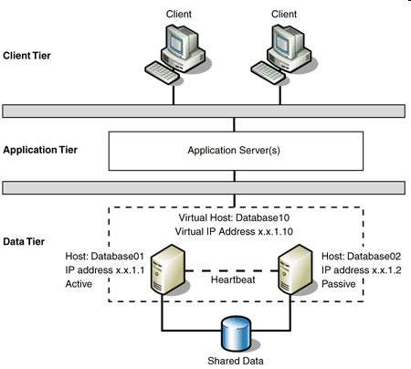
Clusters en Solaris
Redundancia
de nodos
Agentes
Componentes de software que monitorean una aplicación

Slide 18
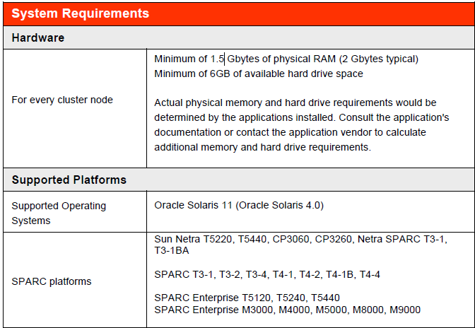
Clusters en Solaris
Mínimo: 1,5 Gb de memoria física RAM
(típicamente 2gb)
Mínimo 6 GB espacio en disco
El espacio en el disco y la memoria física real serán determinados por las aplicaciones instaladas.
Por cada nodo
del cluster

Slide 19

Preguntas ?

Slide 20
Muchas gracias!

